Slide 1
DTS202TC Fundamentals of Parallel Computing
Week 2 – 1, MPI Programming
2023

Slide 2
Recall from last week
Understand what are serial and parallel programs
Share-memory and distributed-memory system
Parallel design – Forster’s method
Basic C programming

Slide 3
Goals today
Distributed-memory programming using MPI
Hands on demo on OpenMPI
Debugging MPI parallel application

Slide 4
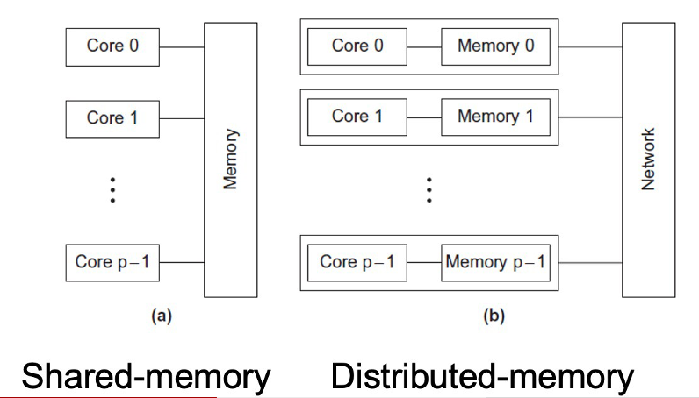
Type of Parallel Systems

Slide 5
Architectures
There are several types:
SISD, SIMD, MISD, MIMD
These classifications were proposed by Michael J.Flynn in 1966
Flynn’s Taxonomy
https://en.wikipedia.org/wiki/Flynn's_taxonomy

Slide 6
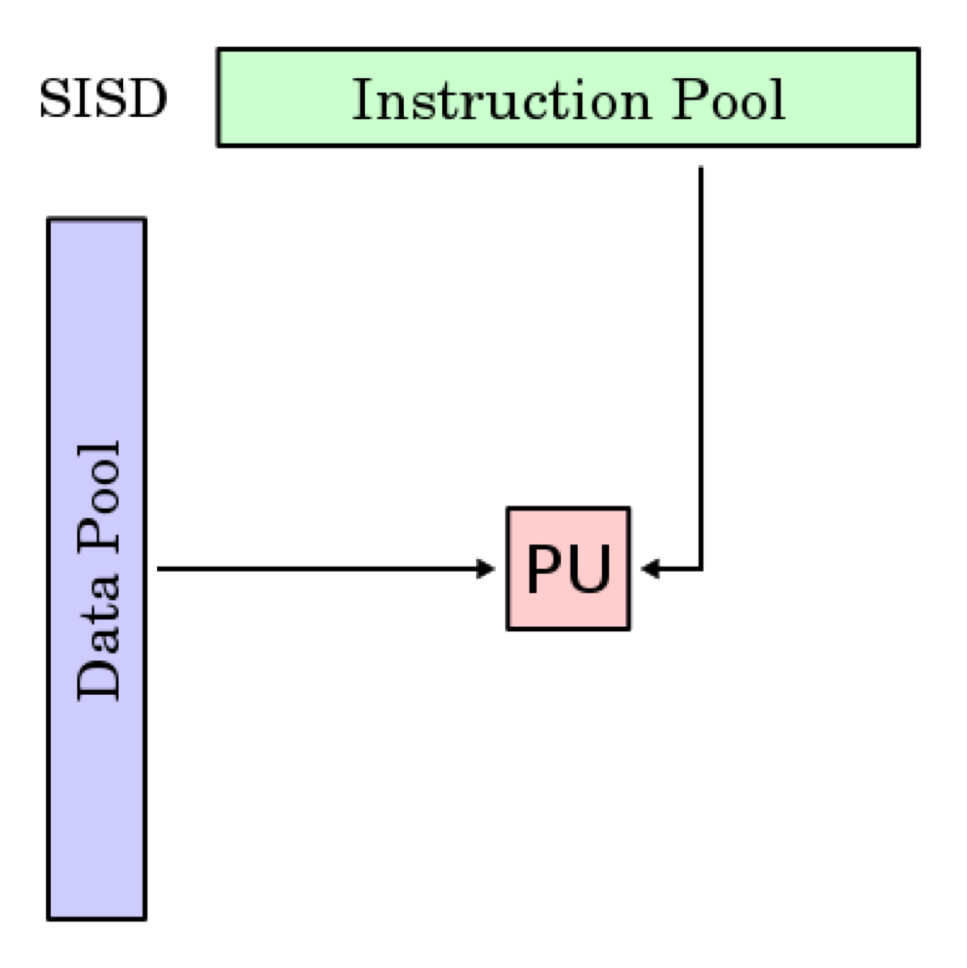
SISD
Single instruction, single data
One CPU, one core, one thread (uniprocessor)
One thing at a time!
PCs up until 2010 or so

Slide 7
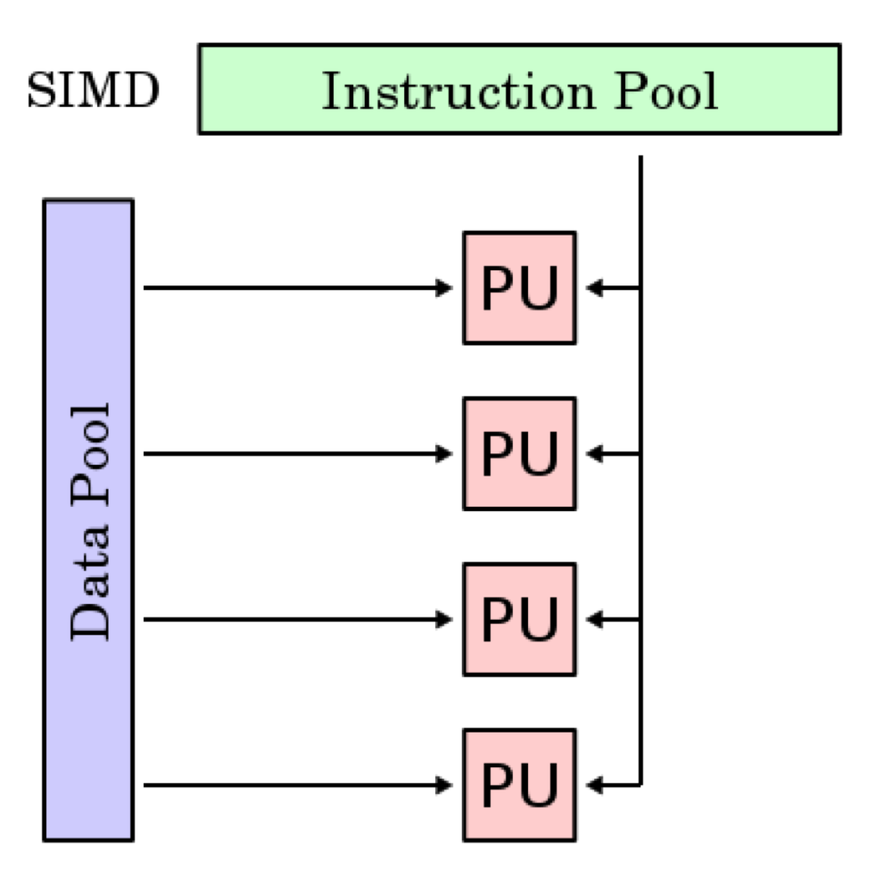
SIMD
Single instruction, multiple data stream
Each PU executes the same instructions on a different piece of the data
Great for highly-parallel workloads (GPUs)

Slide 8
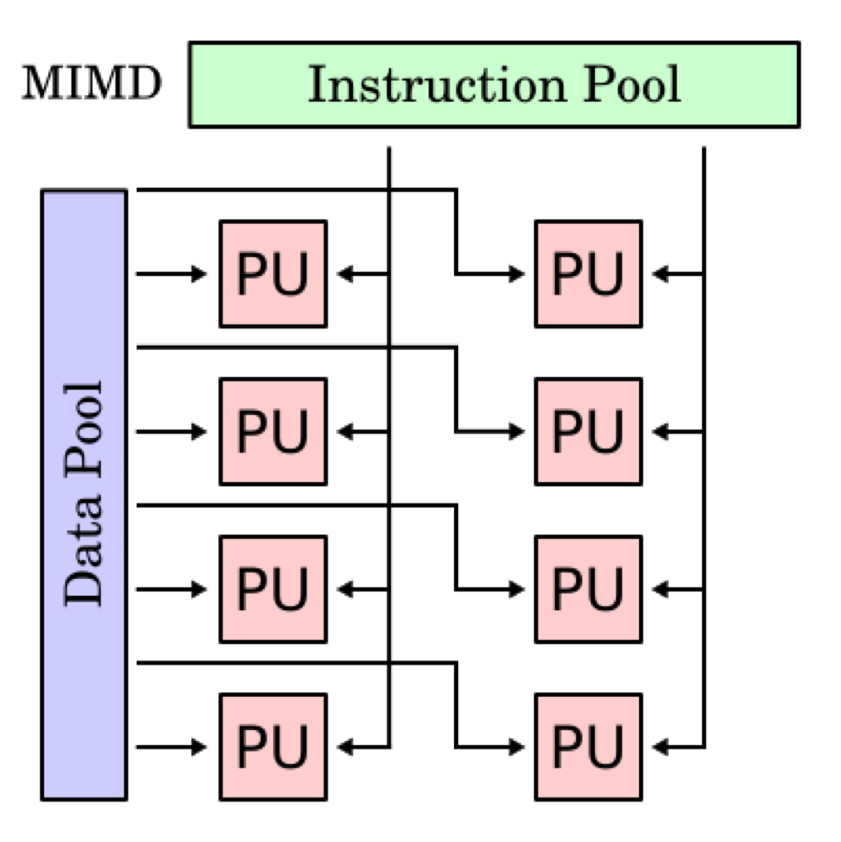
MIMD
Multiple instruction, multiple data
Nodes work independently
Multi-core PCs, distributed systems

Slide 9
Message Passing
Each process can use its local memory for computation
When it needs data from remote process, it has to send messages
MPI forum was formed in 1992 to standardise message passing models and MPI
1.0 was release around 1994, current version v4.0.

Slide 10
Message Passing Interface
It is an interface standard – defines the operations / routines needed for message passing
Implemented by the community for different platforms – meant to be able to run the same code on different platforms without modifications.
Some popular implementations are MPICH, MVAPICH, OpenMPI

Slide 11
MPI Resources
MPI Standard and documentation:
http://www.mpi-forum.org
Other information:
http://www.mcs.anl.gov/research/projects/mpi/index.htm
Tutorial https://mpitutorial.com/tutorials/

Slide 12
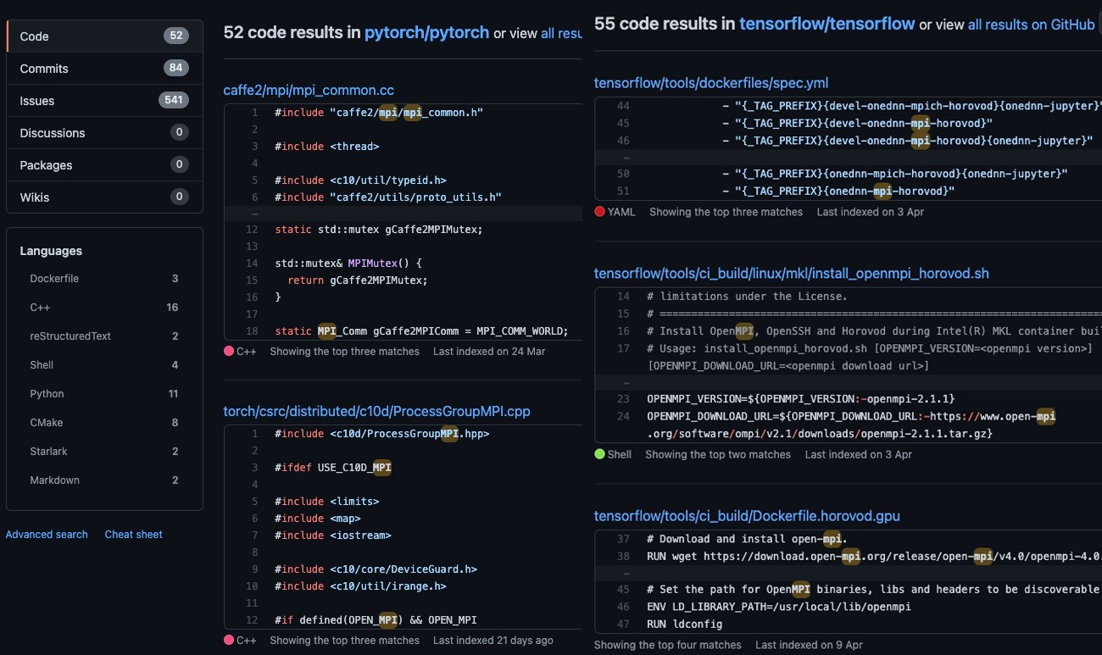
MPI Applications

Slide 13
Installation
OpenMPI has been installed on the Ubuntu we provided
In case you want to install it on your own Ubuntu/Jasen Nano
sudo apt install build-essential
sudo apt-get install openmpi-bin openmpi-doc libopenmpi-dev
In case you want to install it on your Mac:
/bin/bash -c "$(curl -fsSL https://raw.githubusercontent.com/Homebrew/install/HEAD/install.sh)”
brew install openmpi
Also possible on Windows with Cygwin (buggy, not recommended)

Slide 14
Complilation
mpicc -g -Wall -o mpi_hello mpi_hello.c

Slide 15
Execution
mpiexec -n <number of processes> <executable>
Each process runs a "copy" of main
Compile one program
Can branch independently
Can also run on clusters on local network

Slide 16
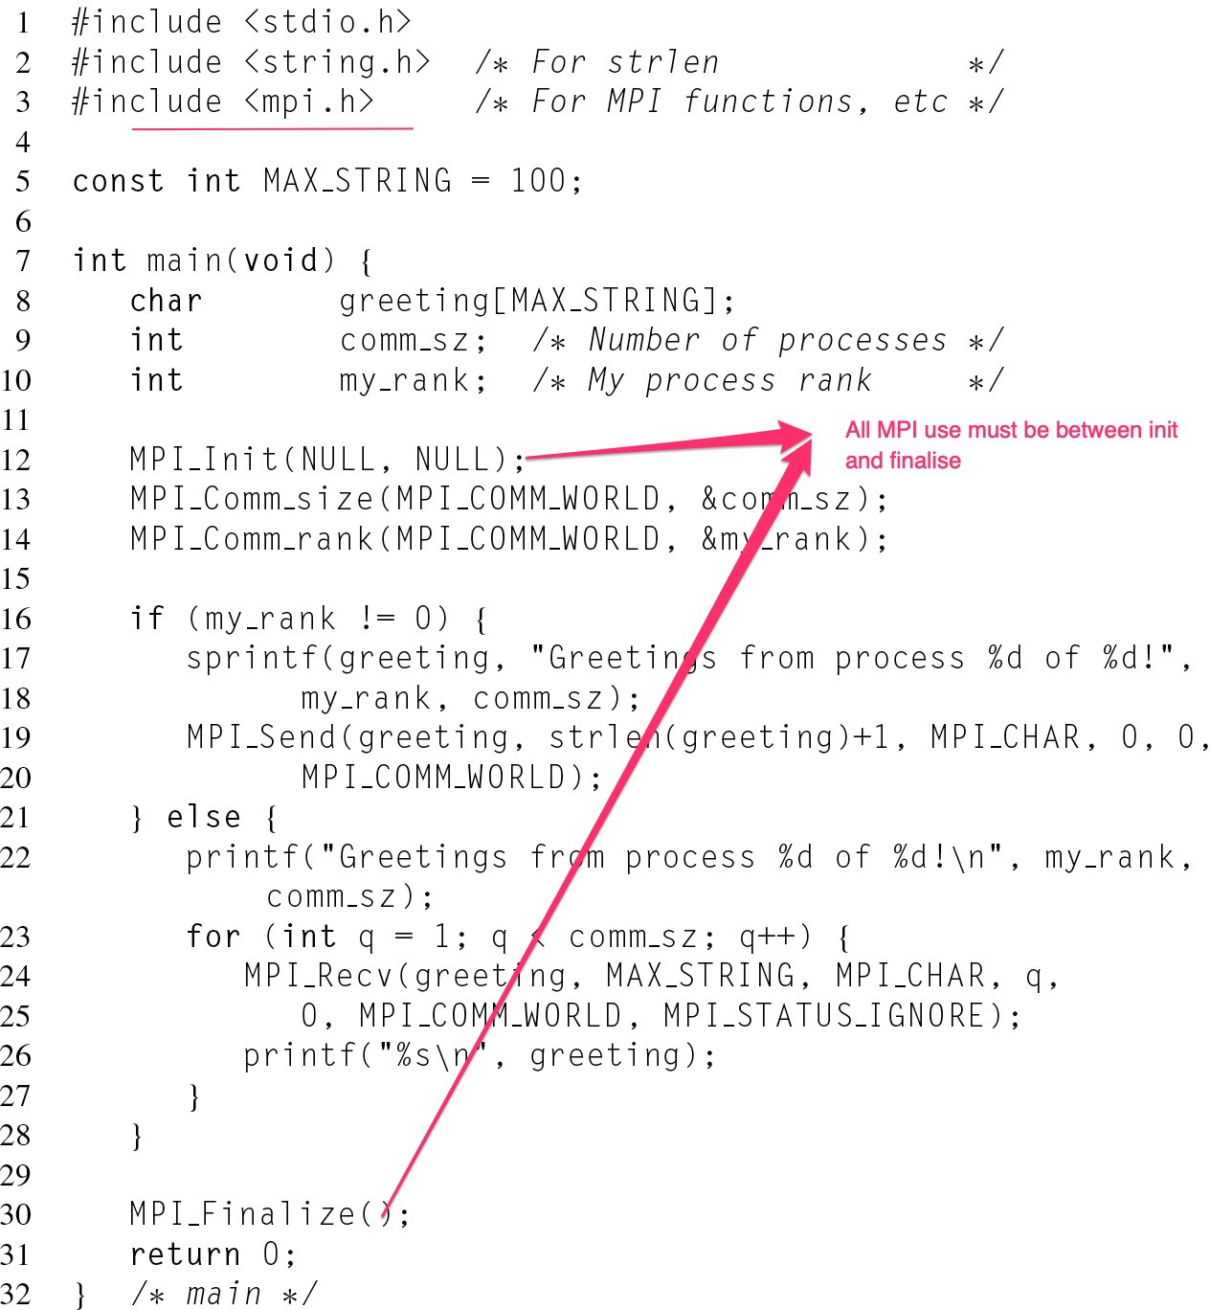
MPI Hello World

Slide 17
MPI_Init()
Needs to be run before you do anything start with MPI_
You can pass in NULL for both of its arguments, or you can pass the argc and argv commandline arguments

Slide 18
MPI_Finalize()
At the end of your MPI program, you must call MPI_Finalize()
This cleans up all the MPI state information
After calling this, you must not call any function start with MPI_

Slide 19
Finding Out the Environment
Two things we want to know
How many processes are participating in this computation?
Which one am I?
MPI provides functions to answer these questions:
MPI_Comm_size reports the number of processes
MPI_Comm_rank reports the rank, a number between 0 and size-1, identifying the calling process

Slide 20
Communicators
A collection of processes that can send messages to each other
MPI_Init defines a communicator that consists of all the processes created when the program started, called MPI_COMM_WORLD
For now, we’ll just use MPI_COMM_WORLD

Slide 21
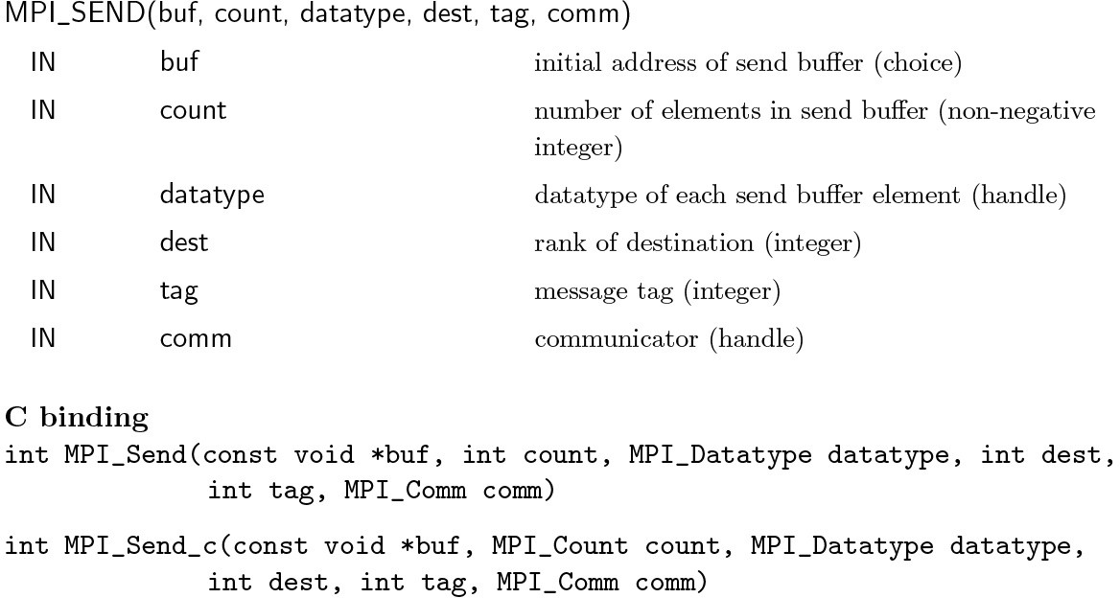
Communication
https://www.mpi-forum.org/docs/mpi-4.0/mpi40-report.pdf page 32.

Slide 22
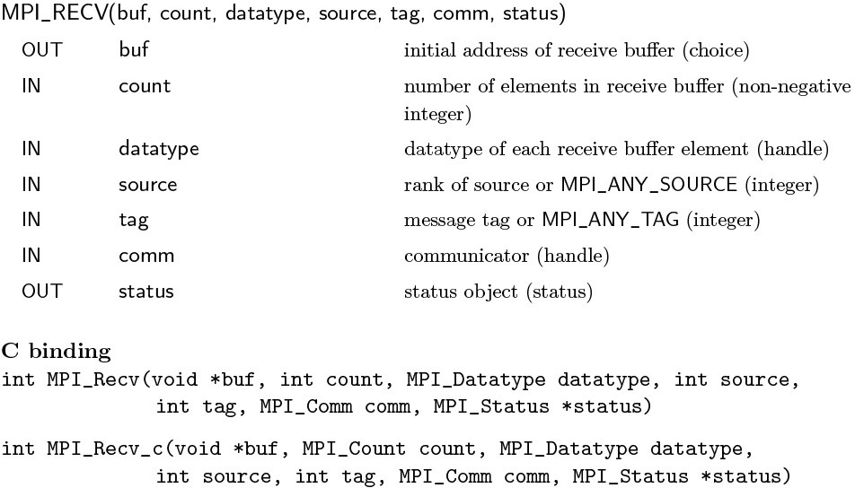
Communication
https://www.mpi-forum.org/docs/mpi-4.0/mpi40-report.pdf page 37.

Slide 23
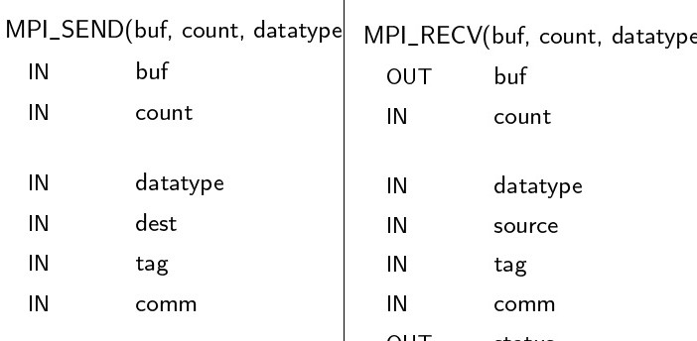
Message matching

Slide 24
Buffering
When calling MPI_Send, MPI may decide to buffer the operation
The message contents are copied into a buffer managed by MPI
The function returns immediately
In other words, nothing has been sent but your program goes on to the next line

Slide 25
Receiving Data
MPI_Recv is considered a blocking call
When you use MPI_Recv, it will wait until data arrives before doing anything
a bit like scanf

Slide 26
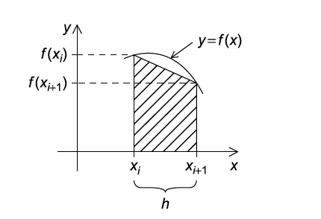
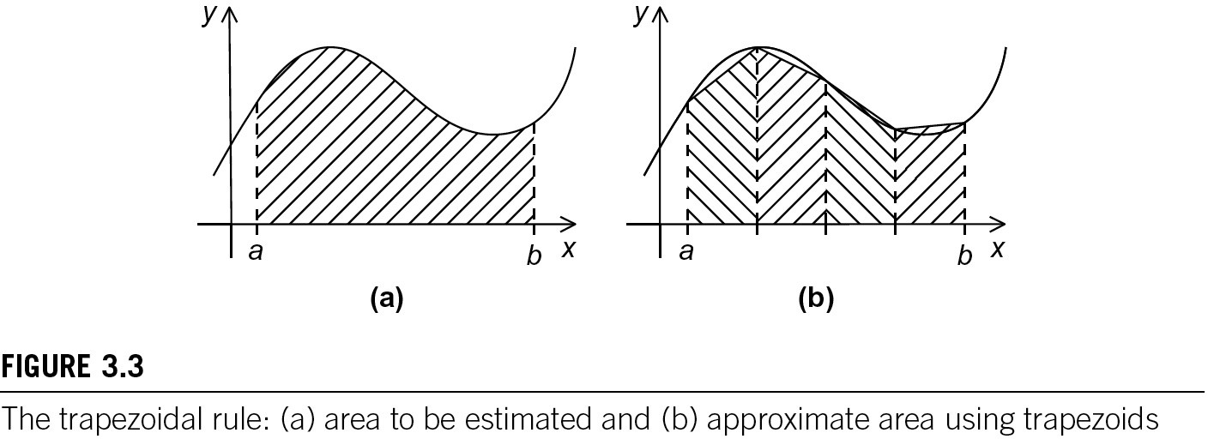

The Trapezoidal Rule in MPI

Slide 27
Pseudo-code for a Serial Program
/* Input: a, b, n */
h = (b-a)/n;
approx = (f(a) + f(b))/2.0;
for (i = 1; i <= n-1; i++) {
x_i = a + i*h;
approx += f(x_i);
}
approx += h * approx;

Slide 28
Parallelising the Trapezoidal Rule
Partition problem into small tasks.
Identify communication channels between tasks.
Aggregate tasks into composite tasks.
Map composite tasks to cores.

Slide 29
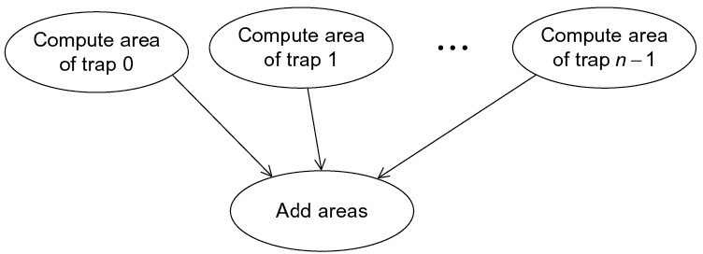
Tasks and communications for Trapezoidal Rule

Slide 30
Parallel pseudo-code
Get a, b, n;
h = (b-a)/n;
local_n = n/comm_sz;
local_a = a + my_rank*local_n*h;
local_b = local_a + local_n*h;
local_integral = Trap(local_a, local_b, local_n, h);
if (my_rank != 0)
Send local_integral to process 0;
else * my_rank == 0 */
total_integral = local_integral;
for (proc = 1; proc < comm_sz; proc++) {
Receive local_integral from proc;
total_integral += local_integral;
}
}
if (my_rank == 0)
print result;

Slide 31
First version
int main(void) {
int my_rank, comm_sz, n = 1024, local_n;
double a = 0.0, b = 3.0, h, local_a, local_b;
double local_int, total_int;
int source;
MPI_Init(NULL, NULL);
MPI_Comm_rank(MPI_COMM_WORLD, &my_rank);
MPI_Comm_size(MPI_COMM_WORLD, &comm_sz);
h = (b-a)/n; /* h is the same for all processes*/
local_n = n/comm_sz; /* So is the number of trapezoids*/
local_a = a + my_rank*local_n*h;
local_b = local_a + local_n*h;
local_int = Trap(local_a, local_b, local_n, h);

Slide 32
First version (continue)
if (my_rank != 0) {
MPI_Send(&local_int, 1, MPI_DOUBLE, 0, 0, MPI_COMM_WORLD);
} else {
total_int = local_int;
for (source = 1; source < comm_sz; source++) {
MPI_Recv(&local_int, 1, MPI_DOUBLE, source, 0,
MPI_COMM_WORLD, MPI_STATUS_IGNORE);
total_int += local_int;
}
}
if (my_rank == 0) {
printf("With n = %d trapezoids, our estimate\n", n);
printf(“of the integral from %f to %f = %.15e\n”, a, b, total int);
}
MPI_Finalize();
return 0;
} /* main */

Slide 33
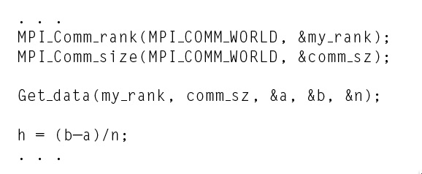
Input
Most MPI implementations only allow process 0 in MPI_COMM_WORLD access to stdin.
Process 0 must read the data (scanf) and send to the other processes.

Slide 34
Function for Reading User Input
void get_input(int my_rank /* in */,
int comm_sz /* in */,
double* a_p /* out */,
double* b_p /* out */,
int* n_p /* out */) {
int dest;
if (my_rank == 0) {
printf("Enter a, b, and nnn");
scanf("%lf %lf %d", a_p, b_p, n_p);
for (dest = 1; dest < comm_sz; dest++) {
MPI_Send(a_p, 1, MPI_DOUBLE, dest, 0, MPI_COMM_WORLD);
MPI_Send(b_p, 1, MPI_DOUBLE, dest, 0, MPI_COMM_WORLD);
MPI_Send(n_p, 1, MPI_INT, dest, 0, MPI_COMM_WORLD);
}
} else { /* my rank != 0 */
MPI_Recv(a_p, 1, MPI_DOUBLE, 0, 0, MPI_COMM_WORLD, MPI_STATUS_IGNORE);
MPI_Recv(b_p, 1, MPI_DOUBLE, 0, 0, MPI_COMM_WORLD, MPI_STATUS_IGNORE);
MPI_Recv(n_p, 1, MPI_INT, 0, 0, MPI_COMM_WORLD, MPI_STATUS_IGNORE);
}
} /* Get input */

Slide 35
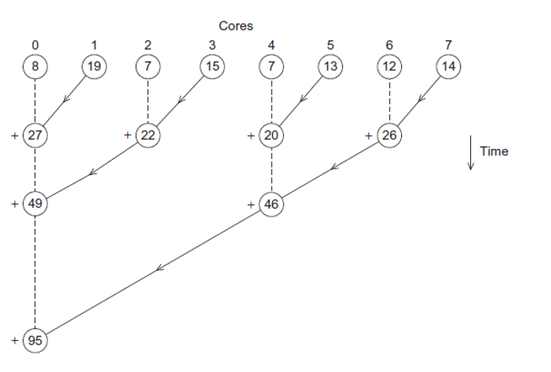
Collective Communication

Slide 36
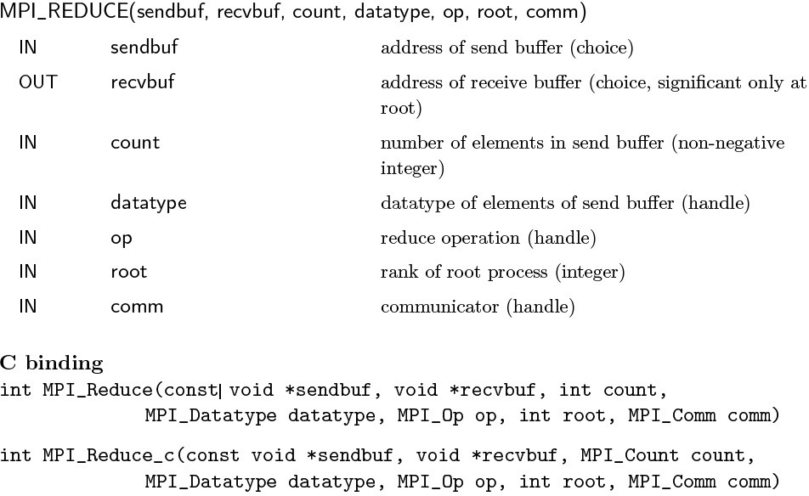
MPI_Reduce
https://www.mpi-forum.org/docs/mpi-4.0/mpi40-report.pdf page 224.

Slide 37
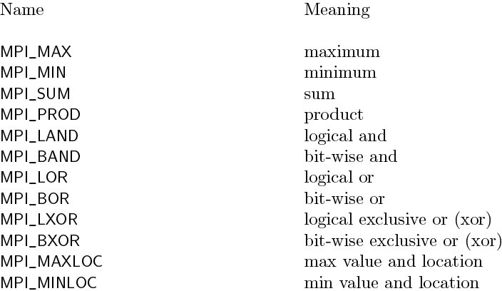
Predefined Reduction Operations in MPI

Slide 38
Another Version
local_a = a + my_rank*local_n*h;
local_b = local_a + local_n*h;
local_int = Trap(local_a, local_b, local_n, h);
/* Add up the integrals calculated by each process */
MPI_Reduce(&local_int, &total_int, 1, MPI_DOUBLE, MPI_SUM, 0, MPI_COMM_WORLD);

Slide 39
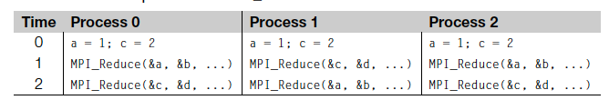
Collective vs. Point-to-Point Communications
All the processes in the communicator must call the same collective function. For example, a program that attempts to match a call to MPI Reduce on one process with a call to MPI Recv on another process is erroneous, and, in all likelihood, the program will hang or crash.
Point-to-point communications are matched on the basis of tags and communicators. Collective communications don’t use tags, so they’re matched solely on the basis of the communicator and the order in which they’re called.

Slide 40
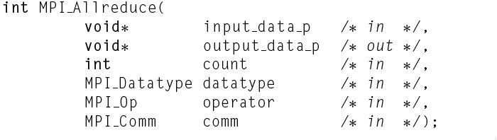
MPI_Allreduce
Useful in a situation in which all of the processes need the result of a global sum in order to complete some larger computation

Slide 41
Debugging MPI Applications (Optional)
Debugging parallel application is tricky, we have multiple processes running
Racing conditions, asynchronous events, and general difficuties of trying to understand N processes executing simutaneously
Both serial and parallel debuggers are useful
gdb(lldb), attach to a single process
parallel debuggers can attach to all the individual processes in an MPI job simultaneously

Slide 42
gdb(lldb) Debugging MPI (optional)
Print out the pid to attach to, while loop to wait there for debugger to attach to
#include<unistd.h>
volatile int i = 0; printf("PID %d ready for attach\n", getpid()); fflush(stdout); while (0 == i) sleep(1);

Slide 43
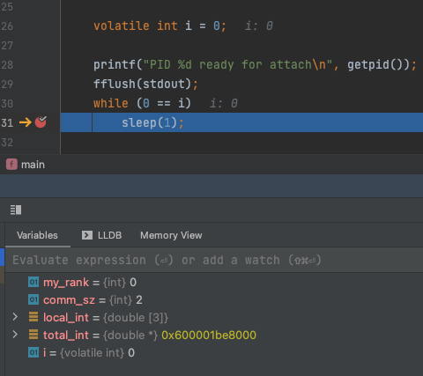

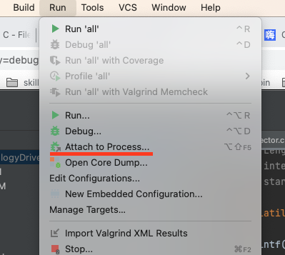
gdb(lldb) Debugging MPI (optional)
set var I = 1 (lldb: expr i = 1) to get out of the while loop

Slide 44
Wrap up
MPI runs on multiple processes
Pointer-to-Point communication
MPI_Send and MPI_Receive
Collective communication
MPI_Reduce
MPI_Allreduce
Debugging parallel application

Slide 45
Next Lecture
Advanced MPI

